Slide 1
Integrated Health Care Application
PIP104 PROFESSIONAL PRACTICE-II
VIVA-VOCE
Batch Number: CBC
Roll Number | Student Name
20201CBC0026 | NIKHIL K ROHIDEKAR
Under the Supervision of,
Dr. Srinivasan T R
Professor
School of Computer Science Engineering & Information Science
Presidency University

Slide 2
Introduction
WHY IS THE PARTICULAR TOPIC CHOSEN?
The topic of the Integrated Health Care Android Application was chosen due to the pressing need for a comprehensive and accessible healthcare solution. Many individuals struggle to find reliable healthcare providers and diagnostic services at reasonable prices. This project aims to bridge that gap by offering a user-friendly, customizable app that connects patients with doctors and hospitals while ensuring affordability and quality. It also addresses the need for a centralized database for healthcare profiles, making it easier for both patients and doctors to manage their healthcare information efficiently. Ultimately, this project seeks to improve healthcare accessibility and overall well-being for all users.
MOTIVATION
The escalating demand for seamless healthcare necessitates innovative solutions. Bridging the gap in current healthcare systems motivates the exploration of streamlined, user-centric platforms.
SCOPE
This project aims to develop a comprehensive healthcare platform, addressing usability issues and enhancing patient-provider engagement. The scope encompasses creating an intuitive system that revolutionizes the healthcare experience for both users and providers.

Slide 3
Literature Review
We give details on the necessary adaptation of the healthcare workflow, usability aspects, and the generalization of our system through models. application is highly promising for different types of users, which help them to maintain a proper health care.
Disadvantages:
• Time consuming to design.
• Unsuitable for creative roles.
PROPOSED SYSTEM
The proposed system the app will show the doctor and the hospitals the user will fix the appoints with the doctor. The user can give the feedback of the hospitals. The user can view the cost of the appoint before booking. The doctors will view the books and give the response the user. The user pays the payments in the app itself.
Advantages:
1. Improved Efficiency:
• The application streamlines healthcare processes, reducing administrative burdens and enhancing overall efficiency.
2. Reduces Scope of Error:
• By automating appointment scheduling and payment processes, the system minimizes the likelihood of errors in data entry and transaction processing.
3. Increased Data Security & Retrieve-ability:
• Robust security measures are implemented to safeguard sensitive healthcare data, ensuring data integrity and accessibility.
4. Improved Patient Care:
• The direct interaction between users and doctors, coupled with efficient appointment management, contributes to an elevated standard of patient care.

Slide 4
Literature Review
Admin Functionality:
Administrators are central to the effective functioning of healthcare management applications. Their responsibilities encompass logging in, adding hospitals, viewing hospital information, and managing user feedback. Additionally, administrators play a vital role in adding and updating healthcare insurance information. The literature underscores the significance of a well-structured administrative interface in healthcare applications. This interface enables administrators to efficiently oversee healthcare institutions, gather essential feedback from both patients and medical professionals, and improve service quality. A responsive system that ensures data security is essential in fulfilling the evolving needs of healthcare administration.
User Functionality:
Users are at the heart of these applications, and their interaction with the platform is characterized by functionalities such as registration, login, hospital and doctor selection, appointment scheduling, tracking appointment status, and easy access to healthcare information. Research highlights the importance of user-centered design in healthcare applications, with a focus on creating interfaces that enable seamless navigation, improving the overall healthcare experience. The inclusion of features such as appointment scheduling and status tracking contributes to increased patient engagement and empowerment, ultimately impacting healthcare outcomes.

Slide 5
Literature Review
Hospital Functionality:
Hospitals using the application can log in, manage their profiles by adding doctors, view appointment schedules, and access user feedback. Studies emphasize the pivotal role of digital tools in hospital administration, demonstrating their potential to enhance operational efficiency. The ability to manage doctors and appointments electronically optimizes resource allocation and organization within healthcare institutions. Monitoring and addressing user feedback provides valuable insights that hospitals can use to enhance the quality of their services, ultimately benefiting patient care.
Doctor Functionality:
Doctors using the application have the ability to log in, access appointment schedules, accept or reject appointment requests, and update their availability status. Effective doctor-patient communication is vital, and the literature highlights the value of healthcare applications in enabling doctors to manage their appointments electronically. This improves scheduling efficiency and patient satisfaction. The capability for doctors to update their availability status ensures that patients have access to real-time information regarding the availability of their healthcare providers.

Slide 6
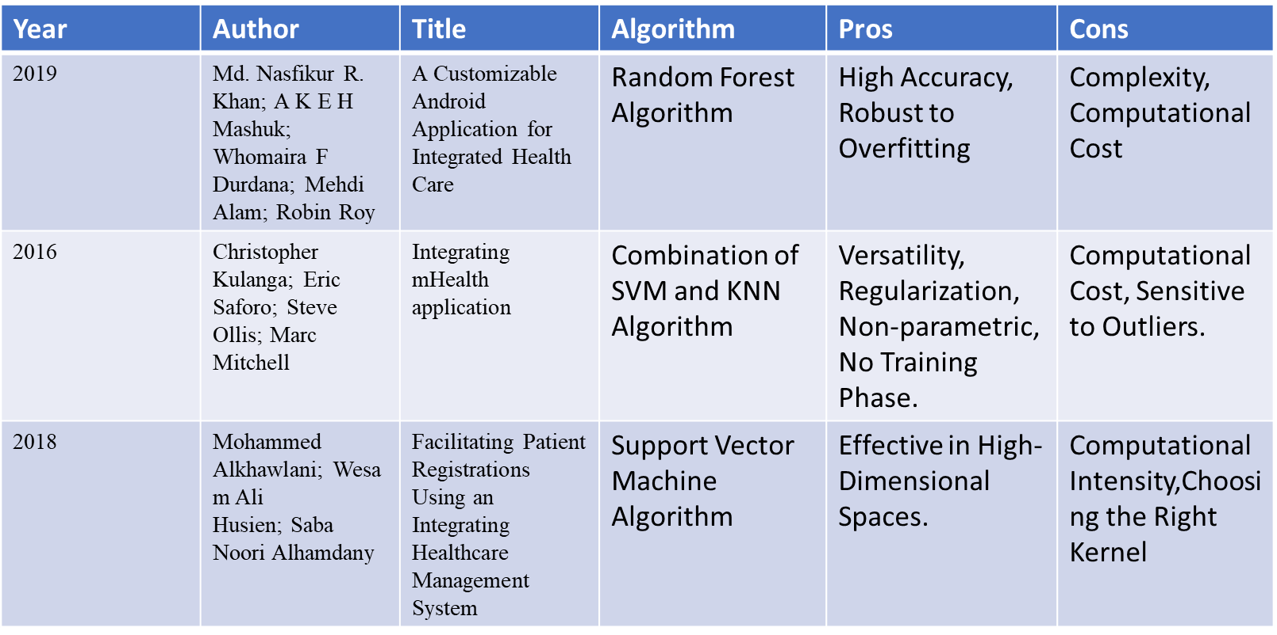
Literature Survey

Slide 7
Research Gaps Identified
Research Gaps in Integrated Healthcare Application Functionalities:
Admin Functionality:
Advanced User Feedback Analysis:
Current methods may lack sophisticated techniques for sentiment analysis and natural language processing in user feedback, hindering administrators' ability to extract nuanced insights for decision-making.
Automated Healthcare Insurance Management:
The process of adding and updating healthcare insurance information may not be streamlined and automated, posing challenges to accuracy and regulatory compliance.
Security and Access Control Measures:
The evolving landscape of cybersecurity threats necessitates ongoing research to implement state-of-the-art security measures and access control mechanisms, ensuring the confidentiality of healthcare administration data.

Slide 8
Optimal User Training and Support:
Research is needed to assess and enhance the effectiveness of training programs and support mechanisms for administrators, ensuring optimal utilization of the system and minimizing errors.
User Functionality:
Personalized Healthcare Experience:
Research should explore methods for personalizing the user experience based on individual health profiles, preferences, and historical data to enhance engagement and adherence to healthcare plans.
Integration with Wearables for Health Monitoring:
Investigate the seamless integration of wearable devices to contribute real-time health data, fostering a more comprehensive and personalized approach to healthcare management.
Usability for Diverse User Groups:
Current applications may not adequately address the usability needs of diverse user groups, including elderly individuals, individuals with disabilities, and those with varying levels of health literacy.
Ethical Considerations in Data Ownership:
Research is essential to address ethical considerations related to user data ownership and consent, ensuring transparency and user empowerment in managing their health information.

Slide 9
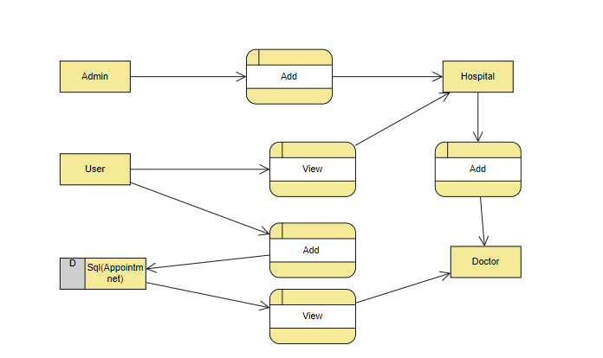
Proposed Methodology
To achieve these objectives, a mixed-method research approach will be employed, involving both quantitative and qualitative data collection and analysis. This will include:
Surveys and questionnaires to gather user feedback and assess user satisfaction with the healthcare management application.
Interviews with healthcare administrators, doctors, and hospital staff to understand the impact of the application on their daily operations.
Data analysis of application usage patterns to assess user engagement and interaction with the platform.
Literature review to provide a comprehensive understanding of the state of the art in healthcare management applications and the impact of technology in the healthcare sector.

Slide 10
Objectives
Investigate the impact of healthcare management applications on healthcare delivery, focusing on the roles and functionalities of administrators, users, hospitals, and doctors.
Assess the importance of user-centered design in healthcare applications and its influence on patient engagement and healthcare outcomes.
Examine the contributions of digital tools in enhancing operational efficiency within healthcare institutions.
Explore the implications of effective doctor-patient communication facilitated by healthcare applications.
Highlight the need for robust security and privacy measures to ensure the protection of healthcare data and compliance with relevant regulations.

Slide 11
System Design & Implementation
Hardware Requirements:
H/W System Configuration: -
Processor - I3/Intel Processor
RAM - 8 GB
Hard Disk - 1TB
Software Requirements:
S/W System Configuration: -
Operating System - Windows 10
JDK - java
SDK - Android
IDE -Android studio
Database` -SQL

Slide 12
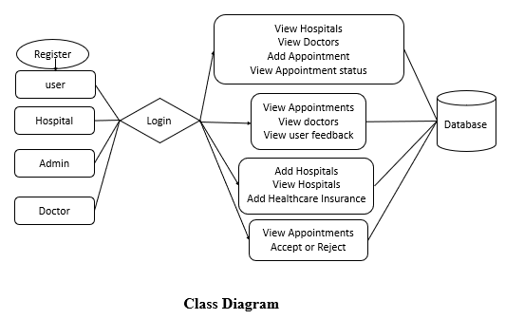
System Design & Implementation
BLOCK DIAGRAM CLASS DIAGRAM

Slide 13
System Design & Implementation
UML diagrams use case

Slide 14
System Design & Implementation
UML DIAGRAM SEQUENCE

Slide 15
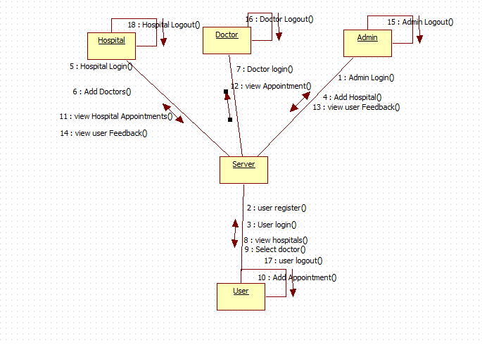
System Design & Implementation
UML DIAGRAM
COLLABORATION

Slide 16
System Design & Implementation
UML DIAGRAMS ACTIVITY

Slide 17
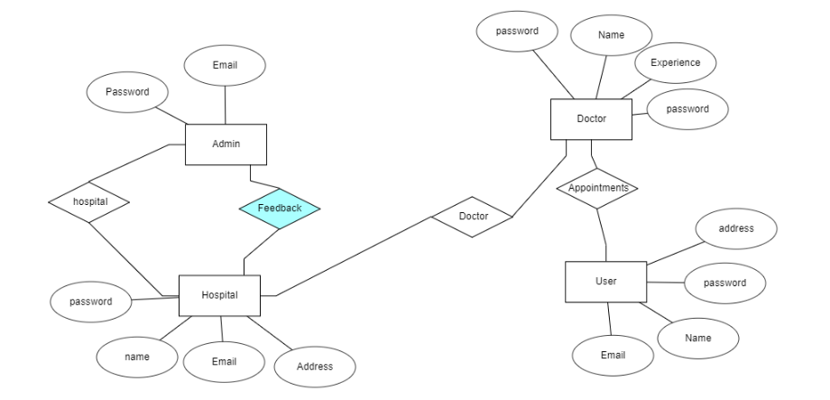
System Design & Implementation
ER DIAGRAM

Slide 18
System Design & Implementation
UML DIAGRAM COMPOENT AND DEPLOYMENT

Slide 19
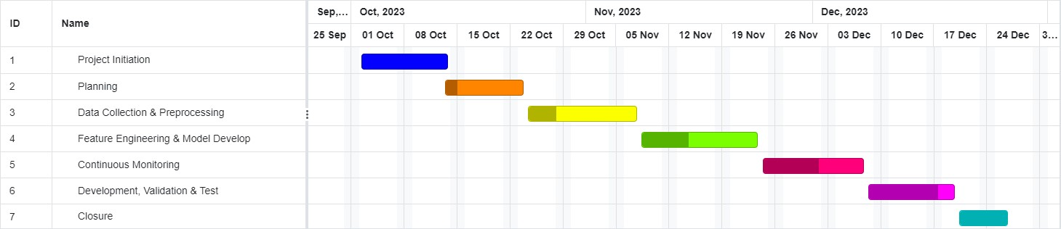
Timeline of Project Gantt Chart

Slide 20
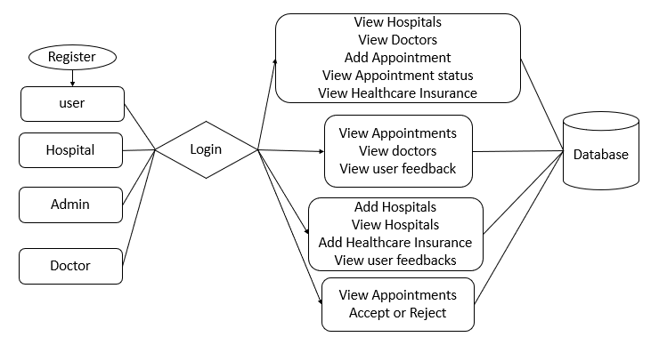
Outcomes / Results Obtained

Slide 21
Testing Cases
Test case id | Test Scenario | Test Steps | Prerequisites | Test Data | Expected result | Actual result | Test status
#CVD001 | To authenticate a successful signup with user data | User navigate the signup page Enter the valid user data Click on signup button | User data | Username Password Mobile Email location | When the user submits the user data, data should be store in database successfully | As Expected, | Pass
#CVD002 | To authenticate a successful login with user data | User navigate the login page. Enter the valid username, password. Click on login button | Username, password | Username password | When the user submits the user data, data should be authenticated successfully | As Expected, | Pass

Slide 22
Conclusion
For administrators, the application provides a robust platform to seamlessly manage and oversee healthcare institutions. Their ability to log in, add hospitals, and access user feedback not only enhances administrative control but also enables the continual improvement of healthcare services. The integration of healthcare insurance information further streamlines the administrative process.
Users, at the core of this application, experience a new level of convenience in healthcare management. The ability to register, log in, and navigate effortlessly to search for hospitals and select doctors simplifies the often complex task of accessing healthcare services. The feature of scheduling appointments and monitoring their status empowers users and promotes greater engagement with their healthcare, ultimately leading to improved outcomes.
Hospitals benefit from streamlined management tools, allowing them to efficiently log in, add doctors, and view appointment schedules. The capacity to access user feedback aids in quality enhancement and the provision of better healthcare services.
For doctors, the application facilitates effective doctor-patient communication through appointment management, thus optimizing scheduling and patient satisfaction. The ability to log in and manage appointments electronically greatly benefits healthcare providers and patients alike.
In sum, the comprehensive functionalities of this healthcare management application have the potential to drive positive change in the healthcare sector. By integrating technology with healthcare services, it addresses the evolving needs of healthcare stakeholders and sets a foundation for improved healthcare delivery, user engagement, and overall healthcare outcomes. As this application is embraced and further developed, it is poised to contribute significantly to the ongoing transformation of the healthcare industry.

Slide 23
References
N. Vigneshwari, M. Dhineshkumar, K.S. Anuvarshini, M. Anisha, M. Sushmitha, Ezhil E. Nithila, "Design of Cloud Computing based Digital Inventory for Administration and Supervision of Hospices Patient Data", 2022 International Conference on Augmented Intelligence and Sustainable Systems (ICAISS), pp.864-870, 2022.
Allen Xavier, Urvashi Dhingra, Valentina Rani Basker, "Patient Monitoring and Assisting: A Real Life Unity3D Application", 2022 1st International Conference on Computational Science and Technology (ICCST), pp.737-741, 2022.
Yeresime Suresh, T Vineeth Kumar, Firdous Afreen, Mohammed Muniruddin, Cheella Ashwith Kumar, "AAYU APP - Mobile Application for Healthcare Management System", 2020 Third International Conference on Smart Systems and Inventive Technology (ICSSIT), pp.808-813, 2020.
K.Nishanthan, & S.Mathyvathana, & R.Priyanthi, & A.Thusara, & Silva, D.I. & Cooray, Dulanji. (2022). The Hospital Management System. International Journal of Engineering and Management Research. 12. 135-149. 10.31033/ijemr.12.5.17.
An Enhanced Entity Model for Converting Relational to Non-Relational Documents in Hospital Management System Based on Cloud Computing
IETE Technical Review

Slide 24
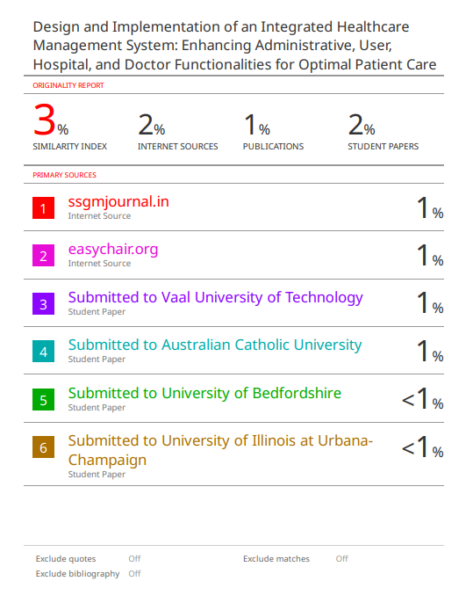
Publication Details

Slide 25
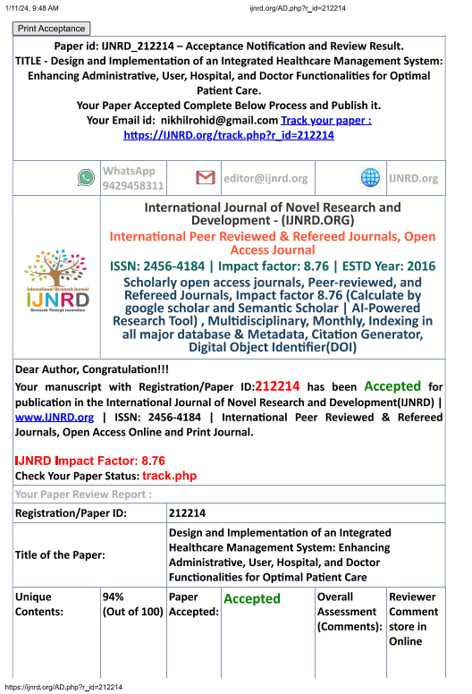
Achievements

Slide 26

Thank You

